Slide 1
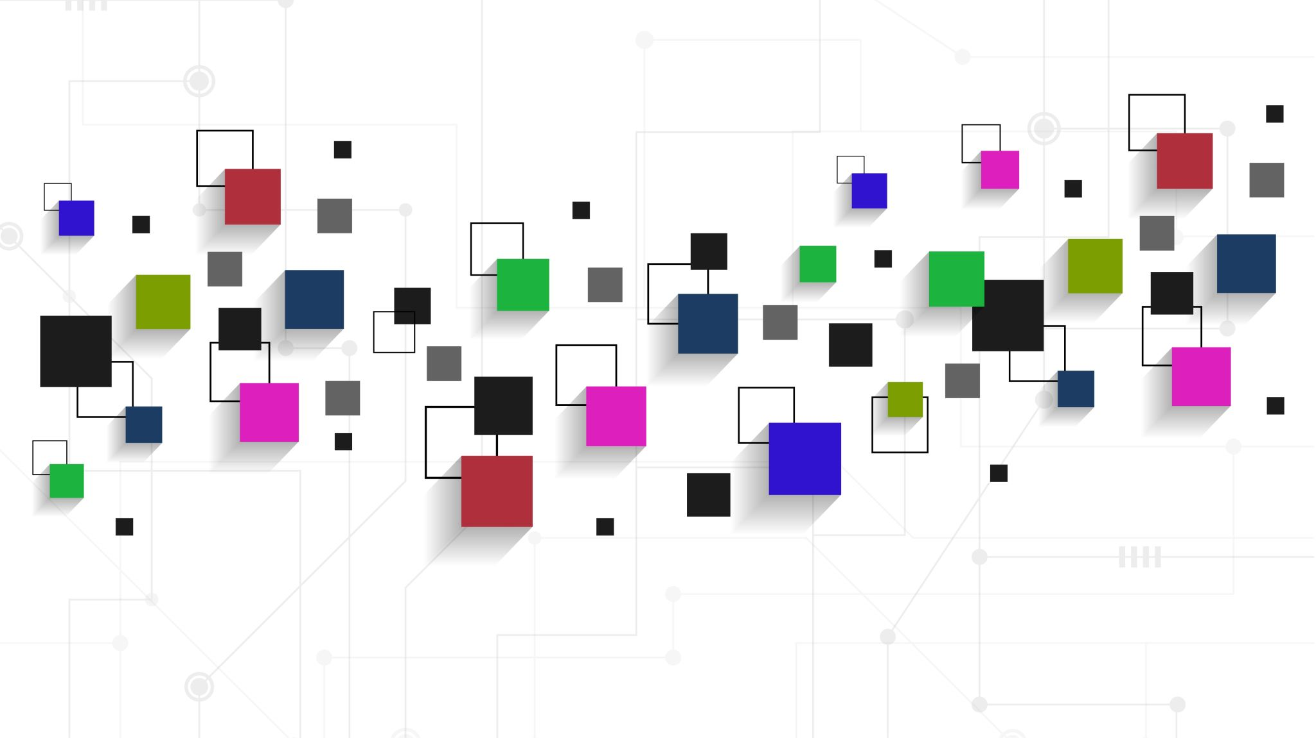
Proctor & Gamble
Company Analysis

Slide 2

Outline
Economy Analysis
Industry Analysis
Company Analysis
History
Brands under P&G
Financial statement Analysis
Stock price simulation and analysis
Investor profile

Slide 3

ECONOMY ANALYSIS
A top-down analysis of P&G's economy would involve looking at the overall economic conditions and trends that may impact the company's operations and performance. Here are some of the key economic factors to consider in the United States (Cincinnati):
Gross Domestic Product (GDP): GDP is a measure of a country's economic output, which it can impact P&G's sales and revenue. The United states GDP grew from 5% in 2018 and a drop in 1% in 2020 and came up by 11% in 2021
Interest Rates: Interest rates can impact P&G's borrowing costs and profitability. The US interest rate currently stands at 5% as at March 2023, it was previously at 4.75%. Wshich is the average rate for the interest rate of the G20 countries
Unemployment Rate in United state as of March 2023 in the United state comes to 3.50% which was previously 3.6%. When employment and income levels are high, consumers tend to have more disposable income to spend on consumer goods like P&G's products. Conversely, when employment and income levels are low, consumer spending may decline, which could impact P&G's sales.
Inflation: Inflation can impact P&G's production costs and profitability. If the cost of raw materials or labor increases due to inflation, P&G may have to increase its prices to maintain its profit margins, which could reduce consumer demand for its products.
Overall, the top-down analysis of the economic situation of the United states which is the headquarters of the New York stock Exchange in which majorly of our industry lies

Slide 4
Industry
We choose the consumer products markets as it is a defense segment
This segment is specific to the cost leaders as they have a broad target market (multinationals) and are not luxurious products
The sector provides a same and stable companies who have been in business for decades and some of their performance are as follows
They are traded on the New York stock exchange
Items/Companies | Johnson & Johnson | P & G | Unilever
Sales/Revenue as of 2022 | 94.9 trillion | 80.1 trillion | $60 trillion
Share Price(as of March 2023) | $153.84 | $148.69 | $51.93
Earnings | 17.9 trillion | 14.7 trillion | 7.6 trillion
PE rations | 24.4 | 26.63 | 16.39

Slide 5
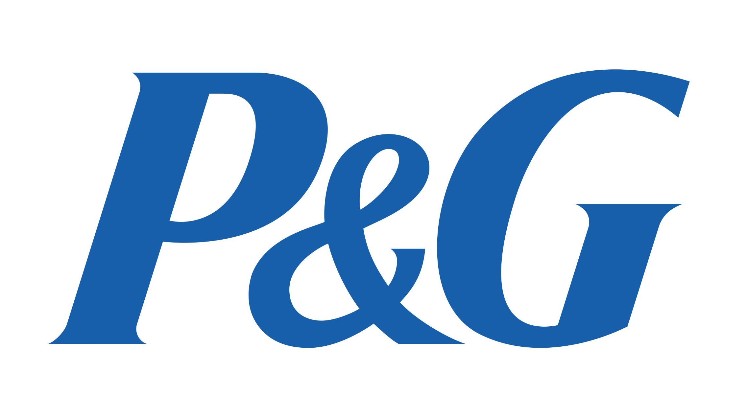
Company Analysis

Slide 6

Brief History
Procter & Gamble Company, major American manufacturer with a diverse line of branded products. Headquarters are in Cincinnati, Ohio. The company was formed in 1837 when William Procter, a British candlemaker, and James Gamble, an Irish soap maker, merged their businesses in Cincinnati.
Procter & Gamble is a very well-known consumer products company, owning major brands like Crest, Gillette, Pampers, and Tide.
The company has paid a dividend for nearly 130 years and has increased dividends for 63 consecutive years

Slide 7
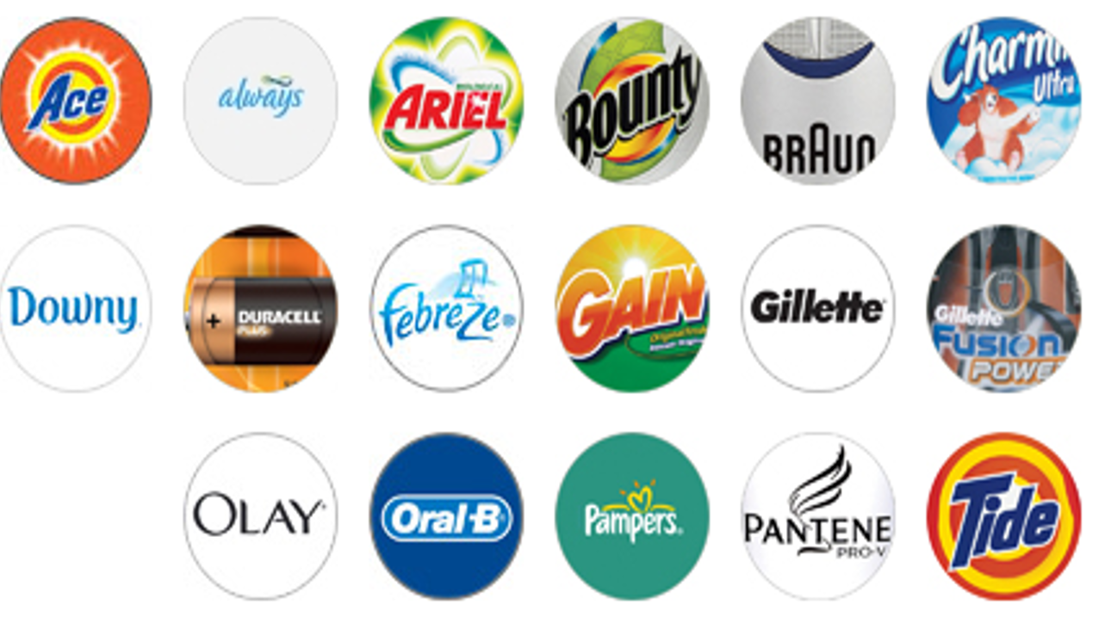
Brands under P&G

Slide 8

Stock price Analysis

Slide 9
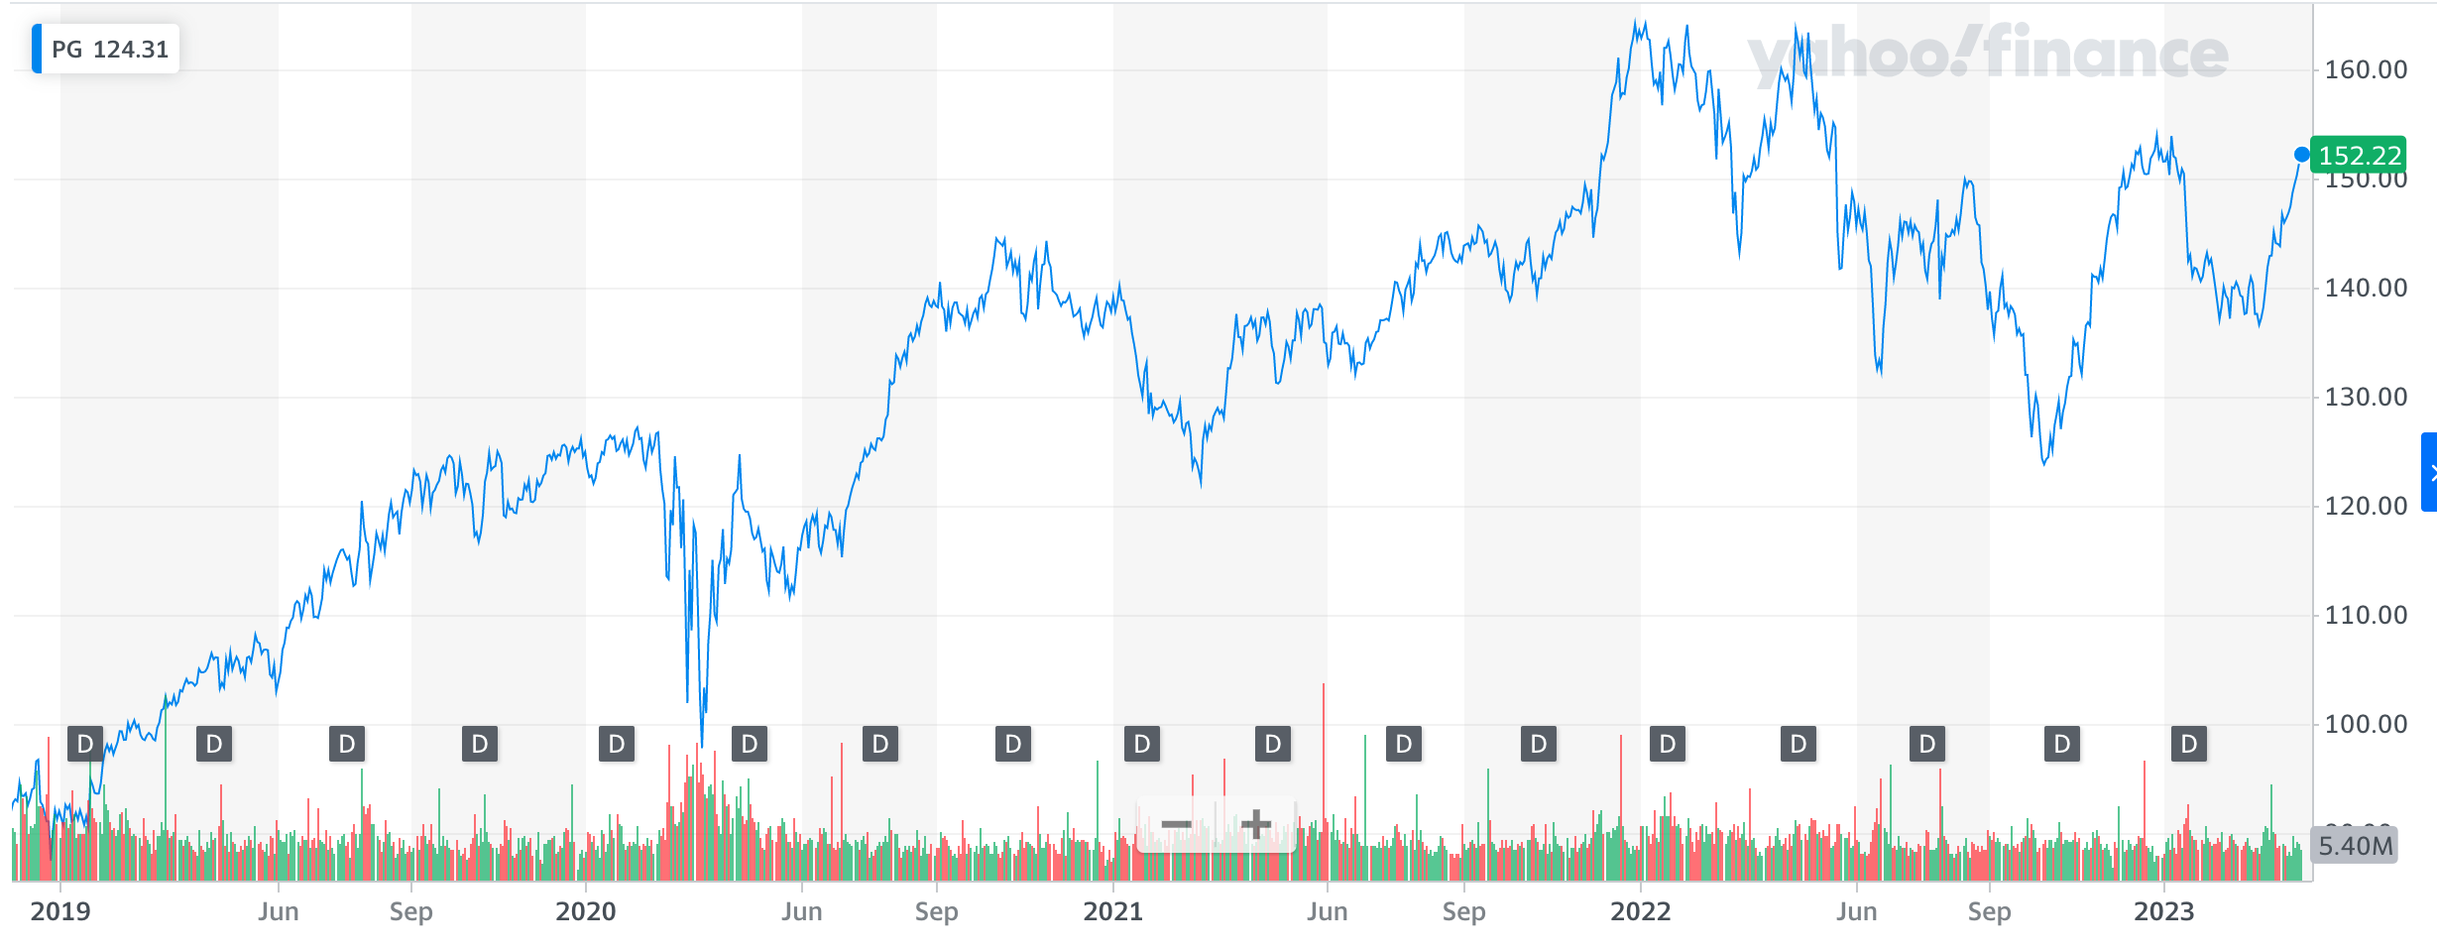
Historical data
Notes:
From the historical data, you talk about the covid scene
That’s why we see a dip in 2020. stock prices were really affected
But in general there has been an increase in the stock prices.

Slide 10
Dicing the stock data
Took data from Jan 2023 to April 2023
Performed;
Simulation using python
ARIMA analysis (checking for seasonality and stationarity)
Forecast the stock prices

Slide 11
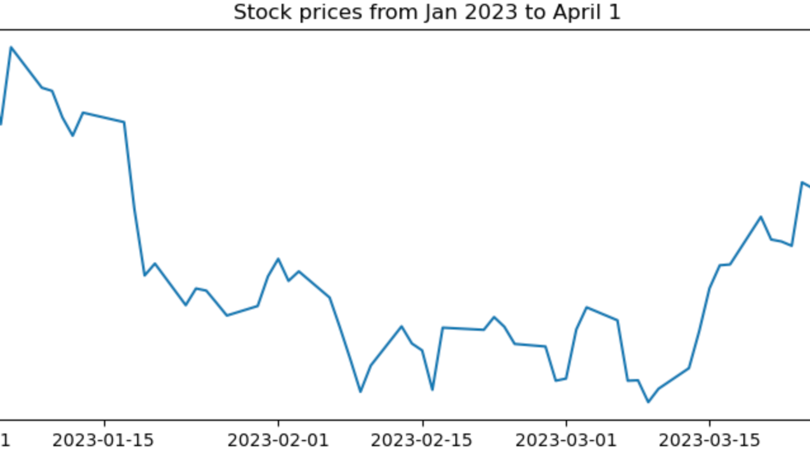
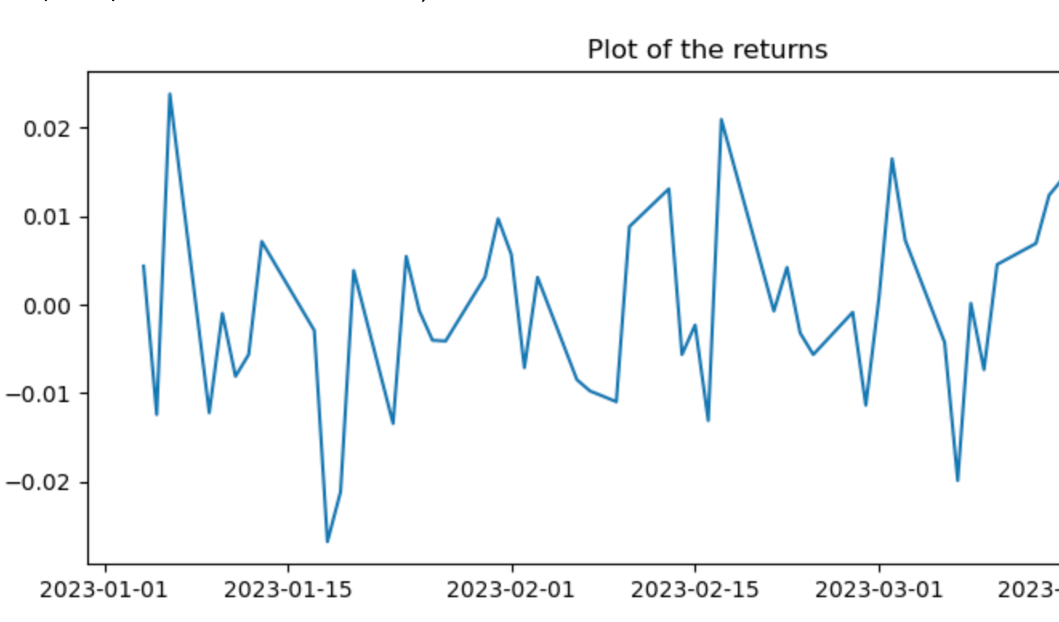
Stock prices & returns

Slide 12
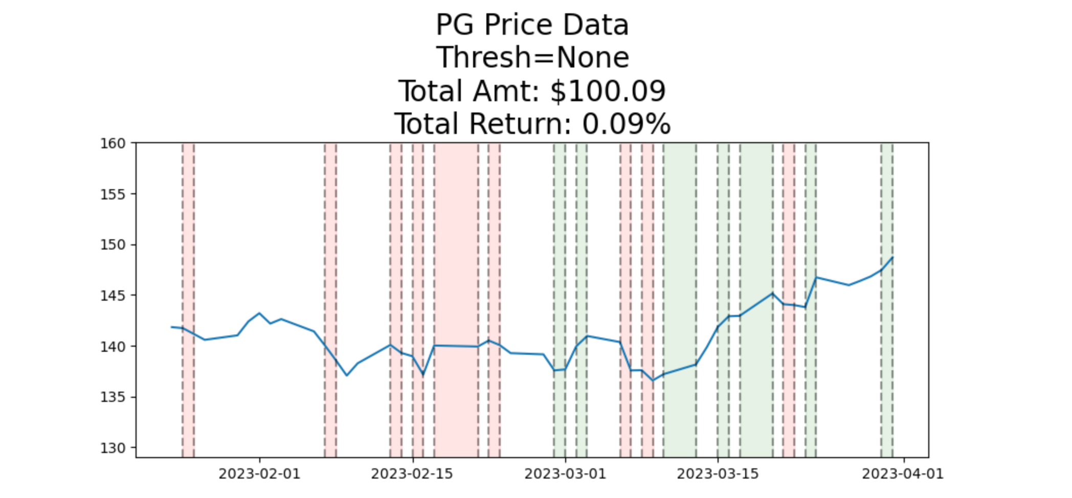
Simulation
How much return will you get from investing in P&G stock.
1 iteration

Slide 13
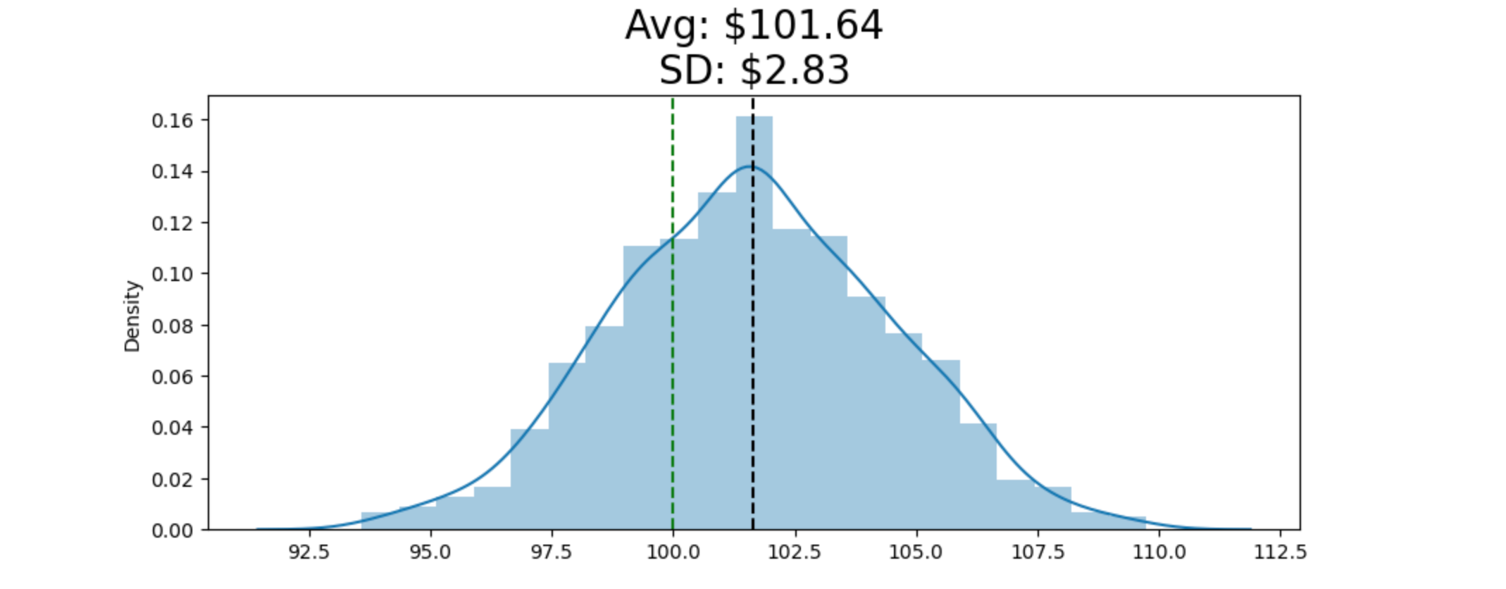
What about 1000 iterations

Slide 14
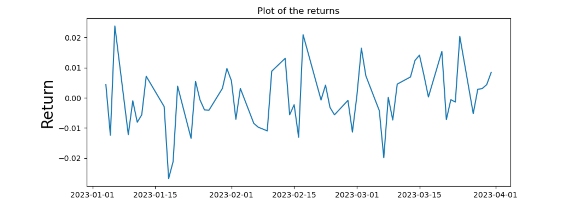
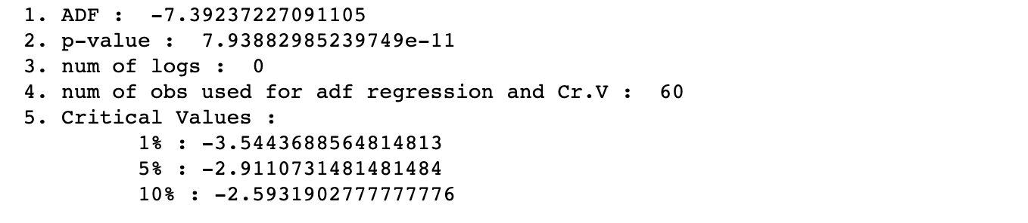
Characteristics of our stock
Clearly, you can tell the return plot is stationary. How?
What about seasonality?

